Slide 1



ETMF 2024
9th School of Theoretical Computer Science and Formal Methods
Serra / Brazil December 3rd, 2024
Safety in Real-Time Systems.
Modeling and Verification with Timed Automata
Prof. Ciprian Teodorov
ciprian.teodorov@ensta-bretagne.fr

Slide 2
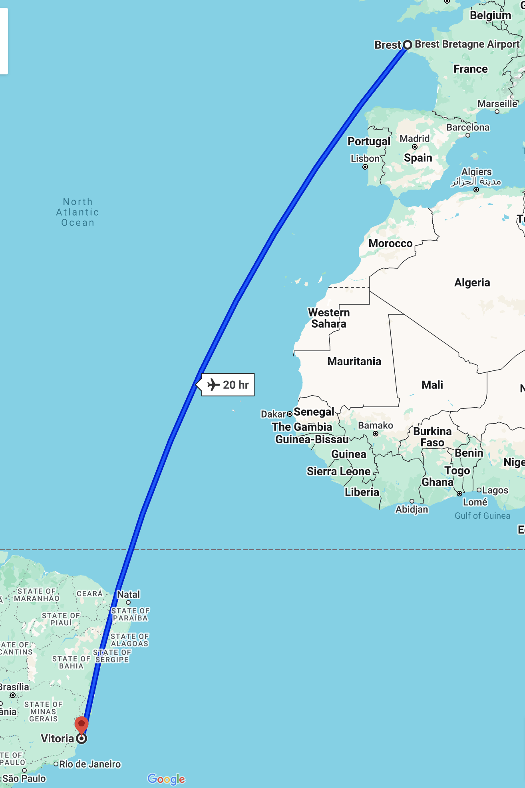

ensta-bretagne.fr/teodorov
Academia @ Lab-STICC, ENSTA Bretagne, Brest
[23-…] Full Professor
[15-23] Associate professor
Lead the OBP2 Semantic Diagnosis & Formal Verification Lab. (http://www.obpcdl.org/)
[13-15] Postdoc
Verification MBSE, Concurrent system modeling, and verification (https://gemoc.org/)
Industry @ Dolphin Integration - Grenoble Area
[11-13] Electronics CAD engineer
Compilation of VHDL, VHDL-AMS for mixed-signal simulation
PhD in Computer Science @ UBO – Brest
[08-11] Model-driven physical design for future nanoscale architectures

Slide 3
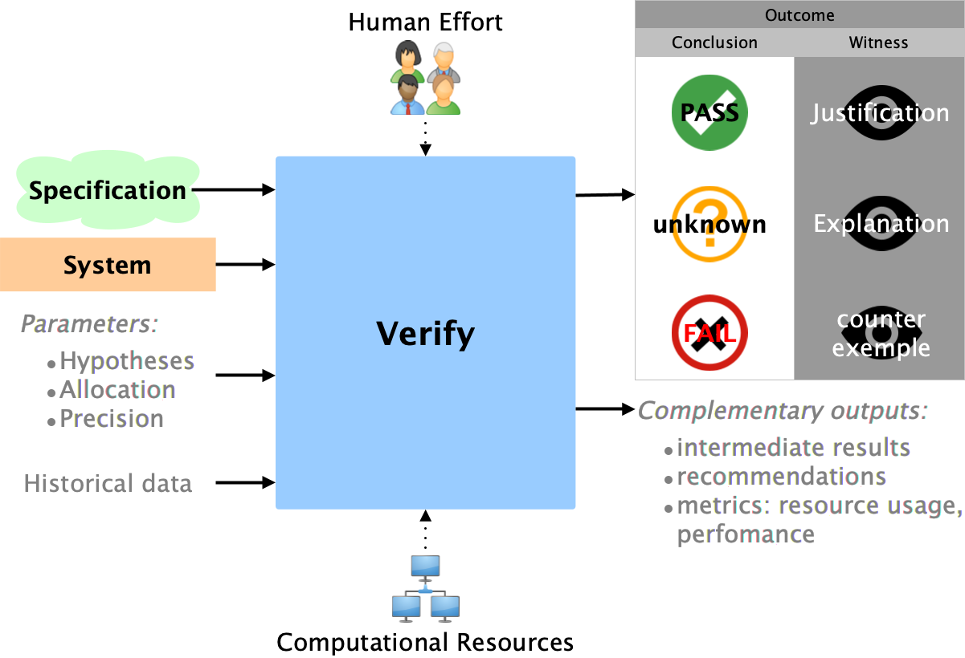

Slide 4
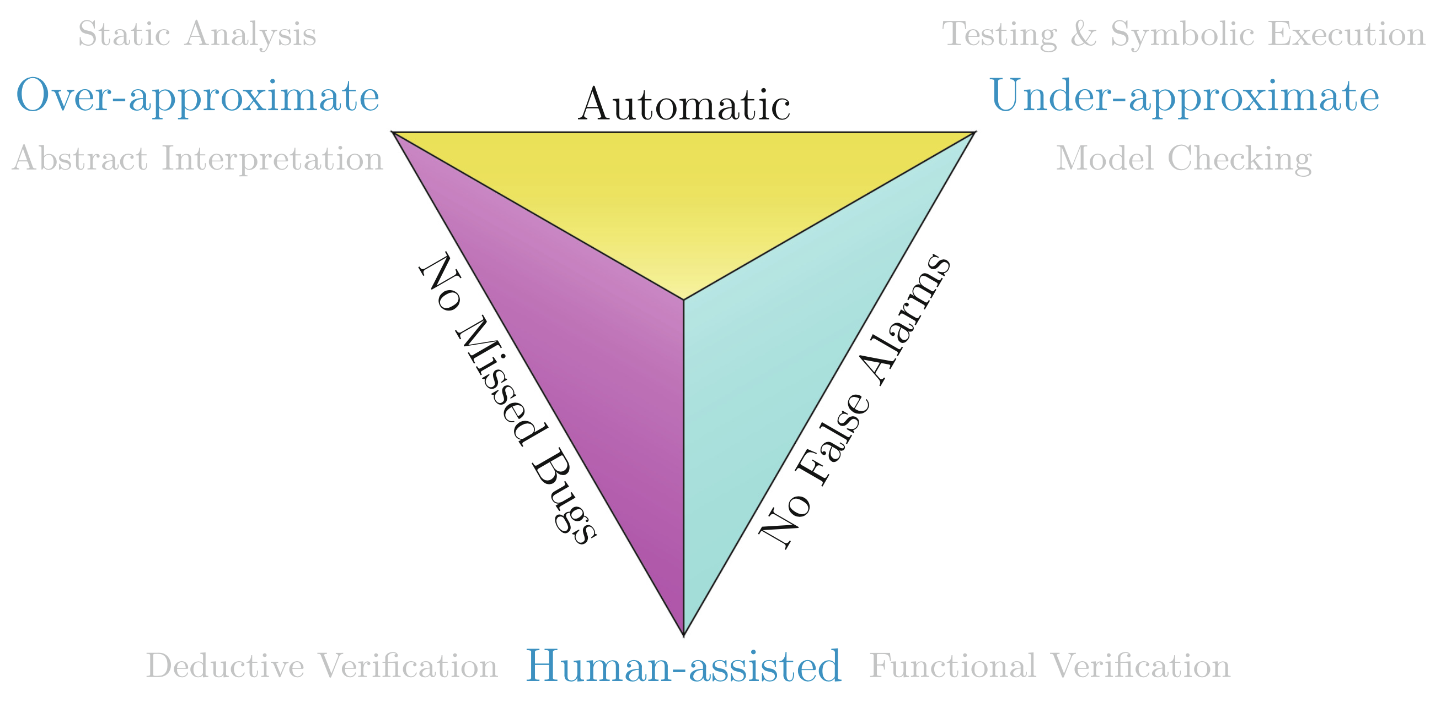
Timed Automata
Brain, M., Polgreen, E. (2025). A Pyramid Of (Formal) Software Verification. In: Platzer, A., Rozier, K.Y., Pradella, M., Rossi, M. (eds) Formal Methods. FM 2024. Lecture Notes in Computer Science, vol 14934. Springer, Cham. https://doi.org/10.1007/978-3-031-71177-0_24

Slide 5

Model checking is a formal verification technique that is highly accessible to engineers.
Many use cases:
Circuit verification : Intel [1]
Driver verification : Microsoft (SLAM [2])
Distributed system verification : Amazon (TLA+ [3])
ETMF’24
Lecture 1
[1] Fix, L. (2008). Fifteen Years of Formal Property Verification in Intel. In: Grumberg, O., Veith, H. (eds) 25 Years of Model Checking. Lecture Notes in Computer Science, vol 5000. Springer, Berlin, Heidelberg. https://doi.org/10.1007/978-3-540-69850-0_8
[2] Thomas Ball, Rupak Majumdar, Todd Millstein, and Sriram K. Rajamani. (2001). Automatic predicate abstraction of C programs. PLDI '01. ACM, New York, NY, USA, 203–213. https://doi.org/10.1145/378795.378846
[3] Chris Newcombe, Tim Rath, Fan Zhang, Bogdan Munteanu, Marc Brooker, and Michael Deardeuff. (2015). How Amazon web services uses formal methods. Commun. ACM 58, 4 (April 2015), 66–73. https://doi.org/10.1145/2699417

Slide 6
The complexity is here:
Analysing a Landing Gear System [1]
with Timed Automata [2]
Failure-free state-space
[1] Boniol, F., Wiels, V. (2014). The Landing Gear System Case Study. In: Boniol, F., Wiels, V., Ait Ameur, Y., Schewe, KD. (eds) ABZ 2014: The Landing Gear Case Study. ABZ 2014. Communications in Computer and Information Science, vol 433. Springer, Cham. https://doi.org/10.1007/978-3-319-07512-9_1
[2] Dhaussy, P., Teodorov, C. (2014). Context-Aware Verification of a Landing Gear System. In: Boniol, F., Wiels, V., Ait Ameur, Y., Schewe, KD. (eds) ABZ 2014: The Landing Gear Case Study. ABZ 2014. Communications in Computer and Information Science, vol 433. Springer, Cham. https://doi.org/10.1007/978-3-319-07512-9_4

Slide 7
100X bigger state-space

Slide 8
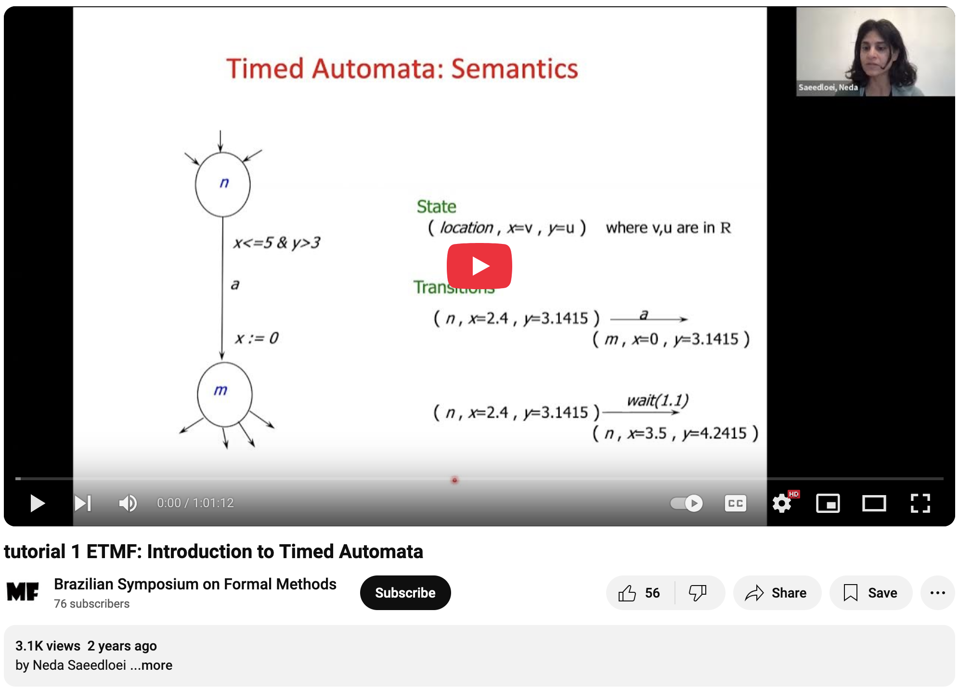
Modeling and Verification with Timed Automata
ETMF 2021:
Timed Automata
Prof. Neda Saeedloei (Towson University)
https://youtu.be/KJAZNXN3aiA

Slide 9

This Photo by Unknown Author is licensed under CC BY-NC

Slide 10
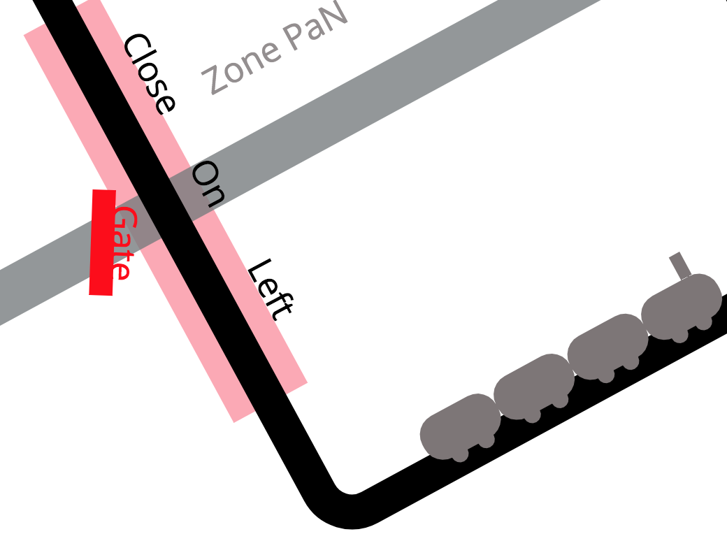
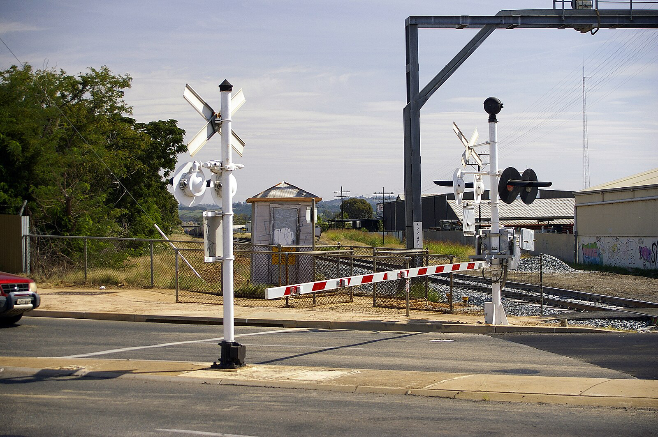
Example: Level Crossing
Goal: design a "Level Crossing Controller" that operates a barrier to stop road traffic when a train is passing.
To detect an incoming train, the crossing is equipped with a "Detection Zone," which is implemented using a track circuit. This sensor not only detects when a train enters but also when the zone is clear.
For both safety and efficiency, once a train is detected in the zone, it must reach the crossing within 50 seconds at most. Once the train is on the crossing, it must clear it within a maximum of 40 seconds. However, the train's speed is limited, so it must remain on the crossing for at least 20 seconds.
The barrier, located at the intersection of the road and the railway, is operated by an electric motor, which is controlled by an electronic circuit with two inputs: "open" and "close."
Upon receiving a command, the barrier takes between 10 and 20 seconds to either fully open or close. If a train reaches the crossing while the barrier is raising, the sequence can be interrupted at any moment.

Slide 11
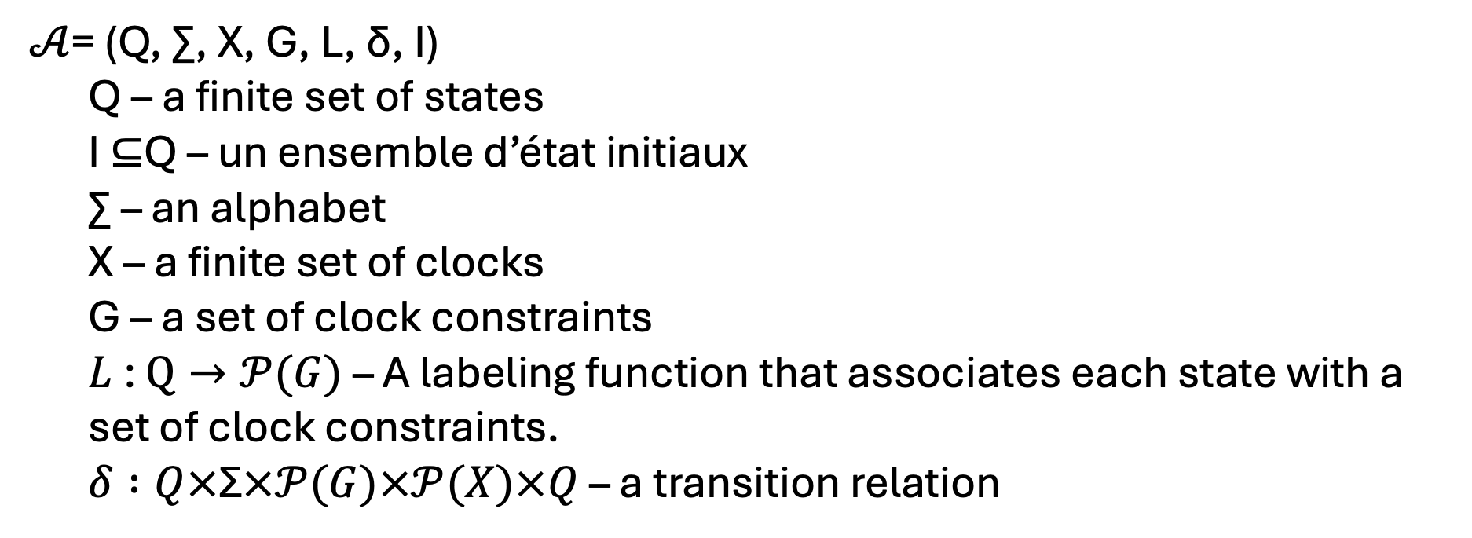
Timed Automata : Syntax
𝒜= (Q, ∑, X, G, L, δ, I)
Q – a finite set of states
I ⊆Q – un ensemble d’état initiaux
∑ – an alphabet
X – a finite set of clocks
G – a set of clock constraints
$L$ : $Q→𝒫(G)$ – A labeling function that associates each state with a set of clock constraints.
$δ :Q×\text{Σ}×𝒫(G)×𝒫(X)×Q$ – a transition relation

Slide 12
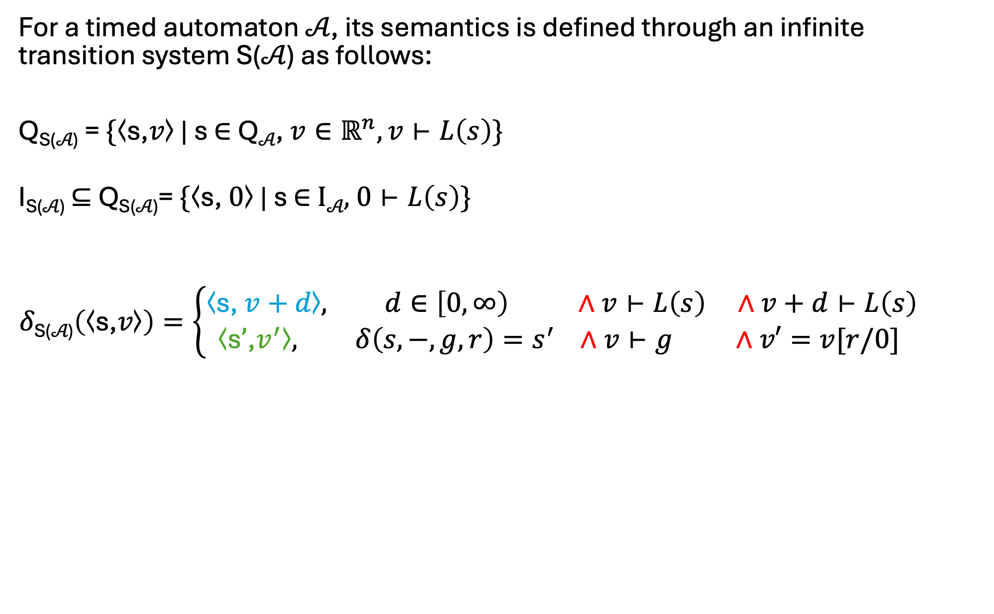
Timed Automata : Semantics
For a timed automaton 𝒜, its semantics is defined through an infinite transition system S(𝒜) as follows:
Q_{S(𝒜)} = $\{\text{⟨}\text{s}\text{,}v\text{⟩ |} \text{s} \text{∈} \text{Q}\text{𝒜}\text{,} v∈ℝ^{n}, v⊢L\left(s\right)\}$
I_{S(𝒜)} ⊆ Q_{S(𝒜)}= $\{\text{⟨}\text{s}\text{, }0\text{⟩ }\text{| }\text{s} \text{∈} \text{I}\text{𝒜}\text{, 0}⊢L\left(s\right)\text{\}}$
$$δ\text{S}\text{(}\text{𝒜}\text{)}\left(\text{⟨}\text{s}\text{,}v\text{⟩}\right)=\left\{\begin{aligned}\text{⟨}\text{s}\text{,} v+d\text{⟩}, d∈\left[0,∞\right) ∧v⊢L\left(s\right) ∧v+d⊢L\left(s\right) \\ &\text{⟨}\text{s}’\text{,}v^{′}\text{⟩}, δ\left(s,−,g,r\right)=s^{′} ∧v⊢g ∧v′=v[r/0] \end{aligned}\right.$$
Time transition
Location switch transition

Slide 13



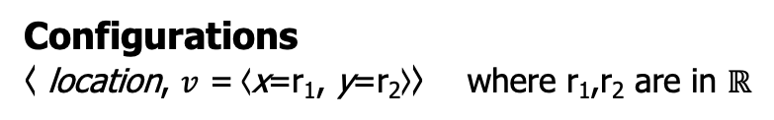
Timed Automata: From Syntax to Semantics
n
Clocks: x, y
Guard
Reset
The only action available on clocks`
x<=5 & y>3
Synchronisation
a?
Semantics
Configurations
$\text{⟨}$ location, $v$ = $\text{⟨}$x=r₁, y=r₂$\text{⟩}\text{⟩}$ where r₁,r₂ are in $ℝ$
x := 0
Transitions
m
a
Location switch transition
$\text{⟨}$n, $\text{⟨}$x=2.4 , y=3.1415$\text{⟩}\text{⟩}$ $\text{⟨}$m, $\text{⟨}$x=0 , y=3.1415$\text{⟩}\text{⟩}$
Time transition
wait(1.1)
$\text{⟨}$n, $\text{⟨}$x=2.4 , y=3.1415$\text{⟩}\text{⟩}$ $\text{⟨}$n, $\text{⟨}$x=3.5 , y=4.2415$\text{⟩}\text{⟩}$
Time transition
wait(3.2)
$\text{⟨}$n, $\text{⟨}$x=2.4 , y=3.1415$\text{⟩}\text{⟩}$ $\text{⟨}$n, $\text{⟨}$x=5.6 , y=6.3415$\text{⟩}\text{⟩}$

Slide 14
Timed Automata: From Syntax to Semantics
n
Clocks: x, y
x<=5
Invariants force the state to change!
Cannot stay in n infinitely
x<=5 & y>3
Location
Invariants
a?
Semantics
Configurations
$\text{⟨}$ location, $v$ = $\text{⟨}$x=r₁, y=r₂$\text{⟩}\text{⟩}$ where r₁,r₂ are in $ℝ$
x := 0
Transitions
m
a
Location switch transition
$\text{⟨}$n, $\text{⟨}$x=2.4 , y=3.1415$\text{⟩}\text{⟩}$ $\text{⟨}$m, $\text{⟨}$x=0 , y=3.1415$\text{⟩}\text{⟩}$
y<=7
Time transition
wait(1.1)
$\text{⟨}$n, $\text{⟨}$x=2.4 , y=3.1415$\text{⟩}\text{⟩}$ $\text{⟨}$n, $\text{⟨}$x=3.5 , y=4.2415$\text{⟩}\text{⟩}$
Time transition
wait(3.2)
$\text{⟨}$n, $\text{⟨}$x=2.4 , y=3.1415$\text{⟩}\text{⟩}$ $\text{⟨}$n, $\text{⟨}$x=5.6 , y=6.3415$\text{⟩}\text{⟩}$

Slide 15
Deriving The Most Useful Pattern in Timed Automata
n
m
T1:
A<>Process.m -- Fails
n
time
0
∞

Slide 16
Deriving The Most Useful Pattern in Timed Automata
n
m
T1:
x<=5
A<>Process.m -- Pass
n
time
0
∞
”cannot be in ‘n’ after 5 time units”
5

Slide 17
Deriving The Most Useful Pattern in Timed Automata
n
m
T1: [x > 2]
x<=5
n
time
0
∞
“cannot fire the state-switch transition before 2 time units”
”cannot be in ‘n’ if x > 5 time units”
Effectivelly models that
to get from n to m
we take between 2 and 5 time units.
2
5

Slide 18
Deriving The Most Useful Pattern in Timed Automata
n
m
T1: [x > 2]
x<=5
x<=3
A<>Process.m -- Fails
A[] not deadlock -- Fails
n
time
0
∞
“cannot fire the state-switch transition before 2 time units”
The wall
”cannot be in ‘n’ if x > 5 time units”
Deadlock zone
m
0
∞
time
”cannot be in ‘m’ if x > 3 time units”
2
3
5

Slide 19
Deriving The Most Useful Pattern in Timed Automata
n
m
T1: [x > 2] / x = 0
x<=5
x<=3
A<>Process.m -- Pass
A[] not deadlock -- Pass
n
time
0
∞
“cannot fire the state-switch transition before 2 time units”
The wall
”cannot be in ‘n’ if x > 5 time units”
m
0
∞
time
”cannot be in ‘m’ if x > 3 time units”
2
3
5

Slide 20
The transition T1 executes in [MIN, MAX]
n
x<=MAX
m
T1: [x >= MIN] / x = 0
What is the earliest time I can leave?
MIN goes to transition guard.
What’s the maximum time I’m allowed to stay?
MAX goes to state invariant
Always reset the clocks by default.
Choosing not to reset a clock should be a deliberate and well-justified decision.

Slide 21
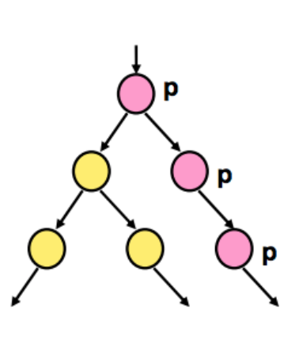
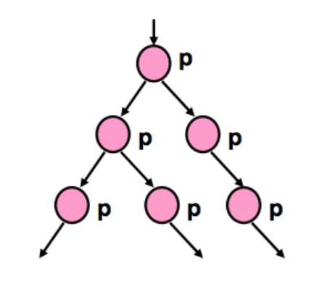
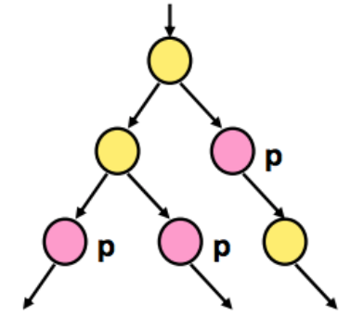
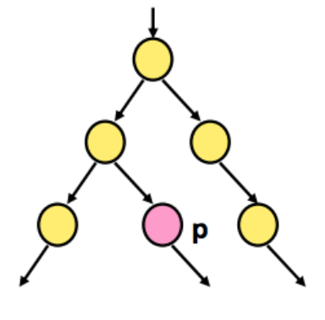
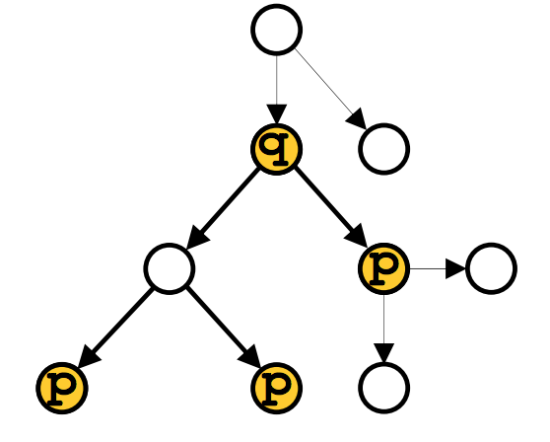
A[] p: Invariantly
A<> p: Eventually
E[] p: Potentially Always
UPPAAL Specifications subset of TCTL
E<> p: Possibly
p --> q: p Leads To q
Propositional Logic + Temporal Layer
- Alice.W
- p1.v < 4
- p1.cs and p2.cs
- not deadlock

Slide 22
Let’s do some UPPAAL now
clone: https://github.com/teodorov/ETMF24_LevelCrossing
start Uppaal
play

Slide 23
Example: Level Crossing
Goal: design a "Level Crossing Controller" that operates a barrier to stop road traffic when a train is passing.
To detect an incoming train, the crossing is equipped with a "Detection Zone," which is implemented using a track circuit. This sensor not only detects when a train enters but also when the zone is clear.
For both safety and efficiency, once a train is detected in the zone, it must reach the crossing within 50 seconds at most. Once the train is on the crossing, it must clear it within a maximum of 40 seconds. However, the train's speed is limited, so it must remain on the crossing for at least 20 seconds.
The barrier, located at the intersection of the road and the railway, is operated by an electric motor, which is controlled by an electronic circuit with two inputs: "open" and "close."
Upon receiving a command, the barrier takes between 10 and 20 seconds to either fully open or close. If a train reaches the crossing while the barrier is raising, the sequence can be interrupted at any moment.

Slide 24
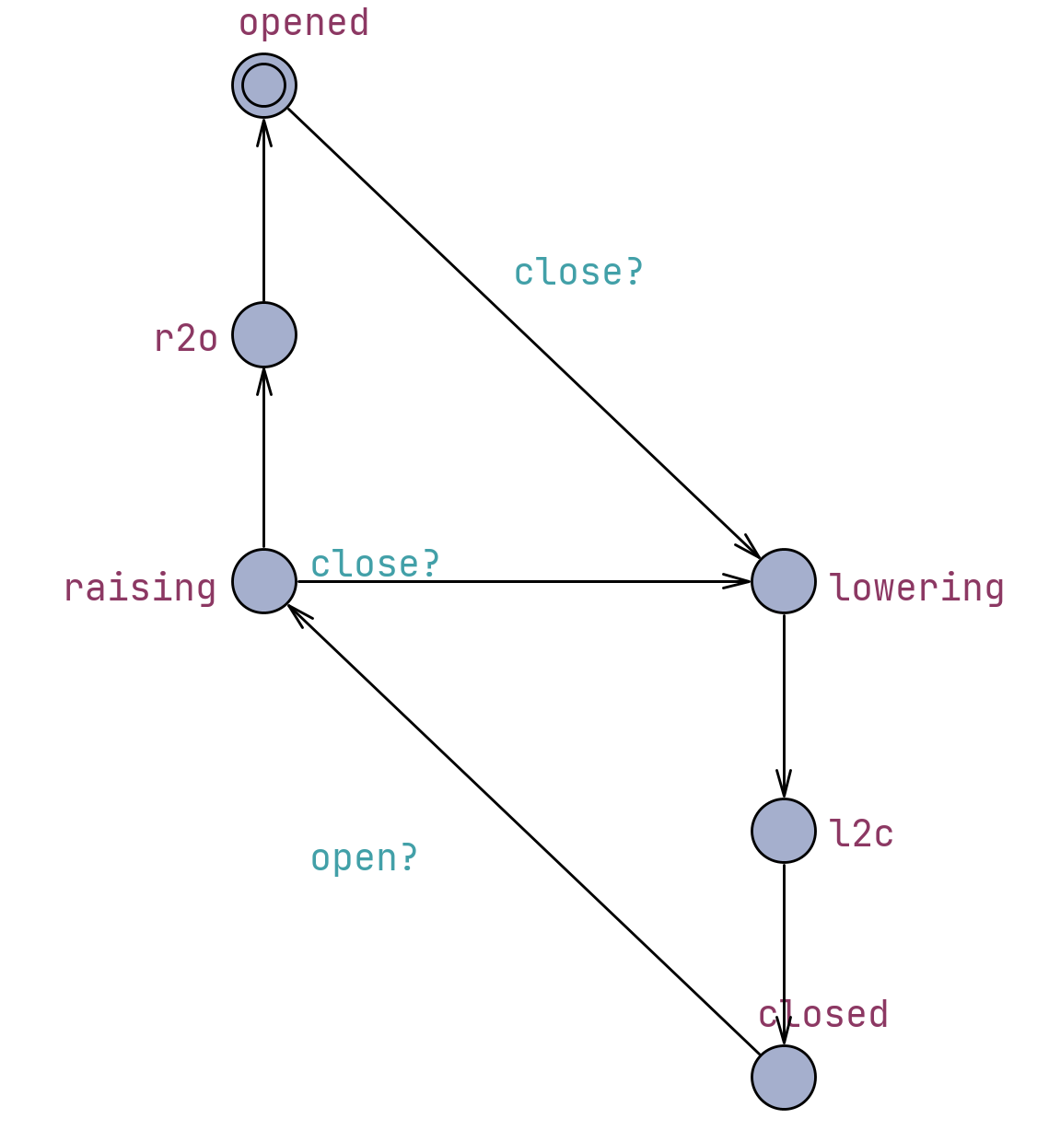
Barrier: Properties
A[] not deadlock
E<> barrier.closed
E<> barrier.opened
barrier.lowering --> barrier.closed
A[] barrier.lowering imply barrier.time >= 0 && barrier.time <= 20
A[] barrier.l2c imply barrier.time >= 10 && barrier.time <= 20
barrier.raising --> barrier.opened || barrier.lowering
A[] barrier.r2o imply barrier.time >= 10 && barrier.time <= 20

Slide 25
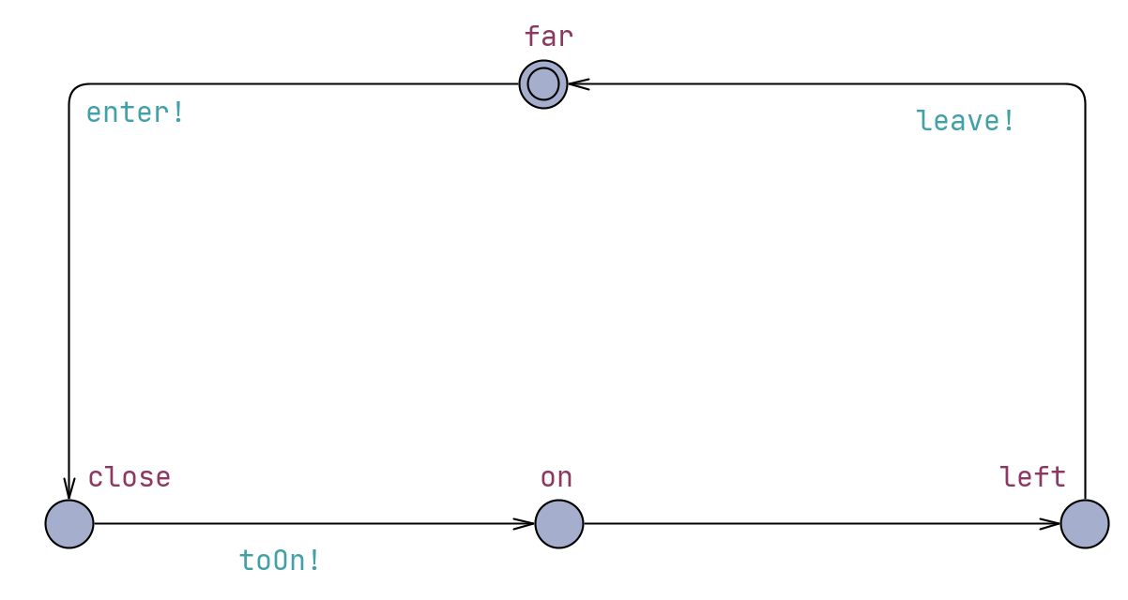
TrackCircuit: Properties
A[] not deadlock
E<> trackCircuit.far
E<> trackCircuit.close
E<> trackCircuit.on
E<> trackCircuit.left
trackCircuit.close --> trackCircuit.on
trackCircuit.on --> trackCircuit.left
trackCircuit.left --> trackCircuit.far
A[] trackCircuit.close imply trackCircuit.time >= 0 && trackCircuit.time <= 50
A[] trackCircuit.left imply trackCircuit.time == 0
A[] trackCircuit.on imply trackCircuit.time >= 0 && trackCircuit.time <= 40
A[] not observer.reject

Slide 26
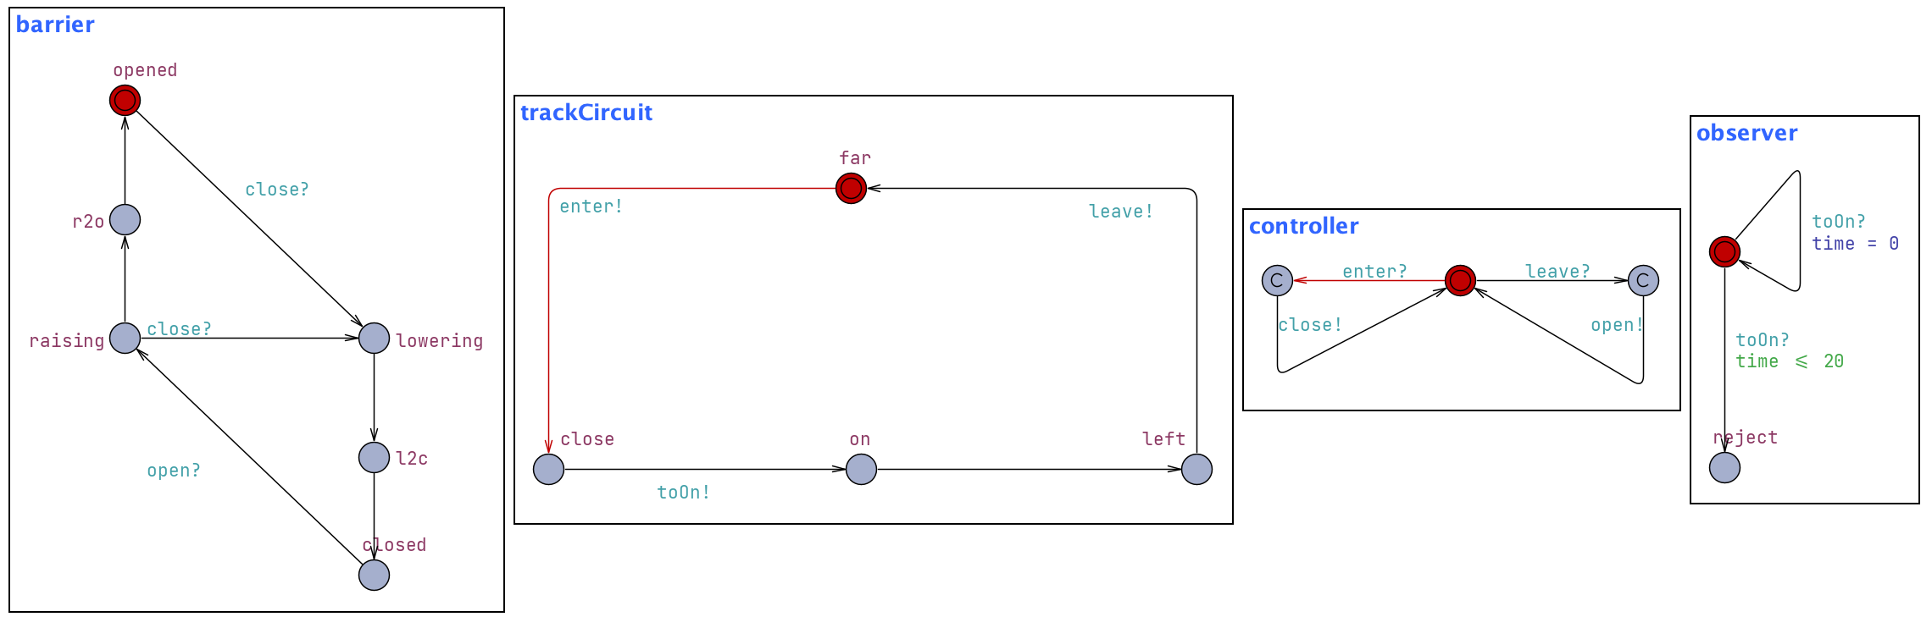
Full System: Properties
A[] not deadlock
A[] barrier.opened imply (not trackCircuit.on)
barrier.closed --> barrier.opened

Slide 27
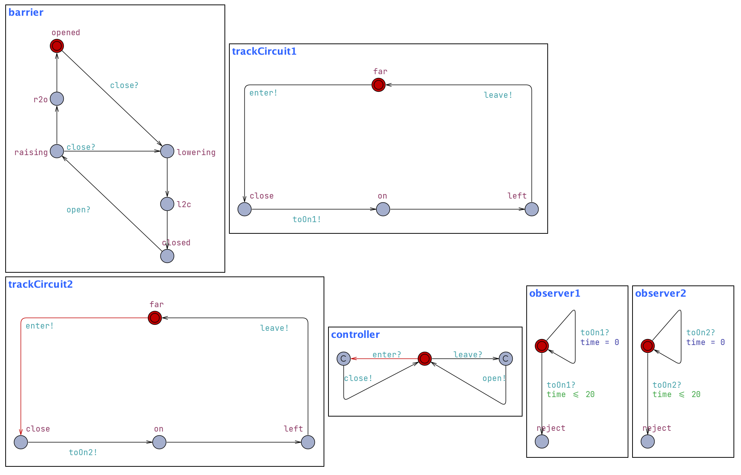
To go further
Consider 2 track circuits
What needs to change
The 3 system properties have to pass
What if the barrier lowering and raising time are asymetric
How to generalize to n trains?
2. A[] barrier.opened imply ((not trackCircuit.on) && (not trackCircuit1.on))

Slide 28
This Photo by Unknown Author is licensed under CC BY-NC

